Slide 1
Material Safety Data Sheets

Slide 2
What You Need to Know
Purpose of the MSDS
How to access an MSDS
How to find and interpret essential safety and health information
How to use MSDS information to protect against chemical hazards

Slide 3
Right to Know
OSHA’s Hazard Communication Standard—also known as the “__________________” law—is based on the idea that you have a right to know about hazardous chemicals you use on the job and a need to know how to work safely with those chemicals
Right-to-know information is communicated in a number of ways, including the ____________, container labels, _____________, and safety training sessions like this one.
The MSDS is the key to all this information because the information found on labels, on signs, and in training is typically based on the information found in the MSDS. There is an MSDS for each ____________________ in the workplace.

Slide 4
MSDS and Hazard Communication
Chemical manufacturers: Determine the hazards of the chemical products they make and provide an MSDS for each product. The Hazard Communication Standard also requires manufacturers to label chemical containers.
Employers: Must make the MSDS available to all employees and train them to understand the hazards of the chemical and the precautions they need to take to prevent injuries and illness. They must also identify and label hazardous material containers and have a written Hazard Communication Program.
Employee (YOU): Must read the MSDS so that you can identify chemical hazards and understand how to work safely with the chemical. You are also required to read the labels on chemical containers before using chemicals.

Slide 5
MSDS—The Foundation of Chemical Safety
The MSDS tells you:
What _______________ are contained in a product
What the _______________ are
What _______________ you need to take
What to do in the event of a __________ or _______________

Slide 6
Accessing an MSDS
Chemical list as index to _______________
Accessible 24 hours per day
Types of Systems:
_______________
_____________________

Slide 7
MSDS Formats
The right-to-know law does not require a standard format for MSDSs. Chemical manufacturers can decide how required information is arranged in the document.
Section __________ & __________may vary
In the past, most MSDSs had _______________
Recently, OSHA has recommended a format designed by the American National Standards Institute (ANSI). The _______________ has 16 sections and is more organized and comprehensive than the 8-section format. OSHA recommends the ANSI format because it is easier to find information.
Same basic information provided regardless of format

Slide 8
Contents of an MSDS: Product Information
Manufacturer name, address, and _______________
Emergency phone number (spills, exposures and treatment)
Name of __________ (brand name, chemical name, chemical product and product number)
__________ of MSDS (up-to-date information)

Slide 9
Chemical Ingredients
Hazardous chemical __________
Percentage of chemical in product
Nonhazardous _______________
Trade secrets – Provide hazards, safety information and first-aid procedures without disclosing ingredients for ____________________.

Slide 10
Exposure Limits
PEL (__________________): over an 8 hour work day
__________ (Short-Term Exposure Limit): over a 15 minute time frame
TLV (Threshold Limit Value): usually the same as __________

Slide 11
Physical Properties
Boiling point and melting point: temperature the material will change from a liquid to a__________ or from a solid to a liquid.
Vapor pressure and _______________ : how fast a chemical will put vapors into the air
Vapor density: whether chemical vapors will rise or _______________ to the ground
Solubility in water and specific gravity: whether a chemical will __________ in water
How chemical looks and smells under ____________________

Slide 12
Health Hazards
Routes of entry: inhalation, mouth and __________ or __________
Health effects and symptoms of exposure: acute or chronic
Effect on existing _________________: asthma or high blood pressure
Target organs

Slide 13
Fire and Explosion Data
Flashpoint: temperature at which a liquid gives off enough __________ to burn
Flammability limits: range of _______________ in the air that can readily catch fire
Hazardous _______________ products: smoke, carbon monoxide, and other toxic fumes

Slide 14
Fire Data (cont.)
Extinguishing measures: proper measures for ___________________ (water, foam or extinguishing medium)
Firefighting equipment and methods: reserved for ____________________ who are properly trained

Slide 15
Reactivity Information
Chemical stability: how chemical changes when subjected to __________________ (temperature, pressure, shock)
Conditions to ______________: make chemical unstable
Incompatibility with ___________________

Slide 16
Reactivity Information (cont.)
Hazardous decomposition products
Some hazardous chemicals can create new __________________ as they react or break down, which means new hazards you have to protect yourself against.
Hazardous polymerization
Polymerization is the ability of a substance to react with itself and release __________ or __________. Most chemicals will not polymerize. Some may will when conditions change, such as when exposed to heat.

Slide 17
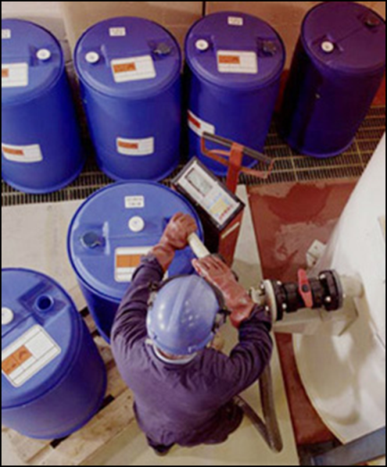
Safe Handling Precautions
Storage recommendations
_______________ requirements
Handling instructions
Warnings
_______________ or antidote
Disposal requirements

Slide 18
Exposure Control
Engineering controls
Ventilation systems
_______________ systems
Dust control systems
_______________ for dipping and coating operations.
PPE
Goggles when working with dust or liquids
_______________ when using chemicals in a potential splash situation
Specific skin protection, such as gloves and _______________
Respiratory protection when _______________ is inadequate.
Hygiene (ex. hand washing)

Slide 19
Spills and Leaks
Evacuation and isolation of area
Evaluation by _______________
Containment
Cleanup

Slide 20
First Aid
Eyes
flush with water for _______________ and then see a doctor
Skin
wash with soap and water and continue __________ the affected area for 15 minutes (unless chemical reacts with water)
Inhalation
move to a location with ________________
Ingestion
seek medical attention
Notes to physician

Slide 21
Additional Information
Some MSDSs may contain additional useful information. For example:
Ecological: how it could affect the _______________
_______________: how it was tested for health hazards
Transportation: _______________ information
Regulatory: OSHA, EPA, or other ________________ that apply to the chemical or state reporting requirements

Slide 22
Label Information
Some MSDS may include a copy of the chemical label (Remember NFPA color and number warning system??)
Health = __________
Flammability = Red
Instability or Reactivity = _______________
Other hazards or _______________= White
Scale: 0 (no hazard) to 4 (extreme hazard)

Slide 23
Key Points to Remember
The MSDS is the foundation of _______________
MSDSs must be accessible at _______________
Always read the __________ before working with a chemical
Ask an ______________ if you still have questions about hazards or precautions

