Slide 1
What is biotechnology?

Slide 2
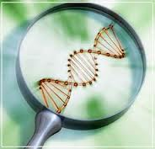
What is biotechnology?
Using cells (and other living materials) to make useful products

Slide 3
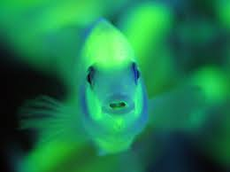
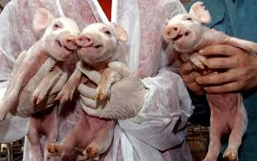
For example…
Print an organ
Test for cancer using saliva
Make fuel out of corn
Breed fish that glow in the dark
Spy with a cyber roach
Clone animals

Slide 4
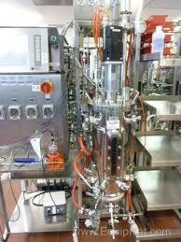
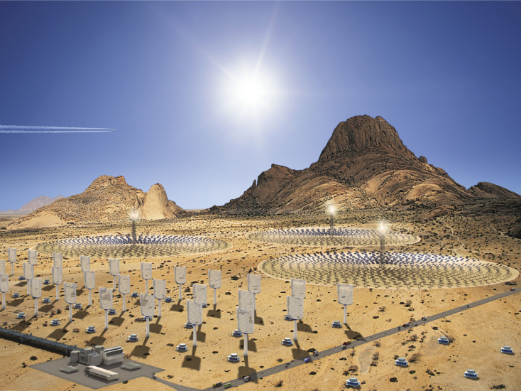
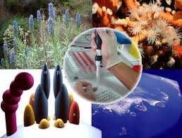
So many fields in biotech
Equipment
Environmental concerns
Medicine and drugs
Food and farming

Slide 5
So many jobs in biotech
Scientific
Nonscientific
research and development (new stuff)
manufacturing and production (making stuff)
clinical research (curing stuff)
quality control (making good stuff)
medical devices/biomedical engineering (technology and life stuff)
computer technology
marketing and sales
business
legal affairs

